Slide 1
Design and Analysis of Algorithms
Design Strategies
Divide & Conquer Approach
Dr. Hamid Ali
hamid.ali@ntu.edu.pk

Slide 2
Design Strategies
Brute Force
Divide and Conquer,
Dynamic programming
Greedy Approach
Graph Theory

Slide 3
Outline
A General Divide and Conquer Approach
Sorting Algorithms:
Merge sort
Heap Sort
Quick sort

Slide 4
A General Divide and Conquer Algorithm
Divide the problem into a number of sub-problems
Similar sub-problems of smaller size
Conquer the sub-problems
Solve the sub-problems recursively
Sub-problem size small enough => solve the problems in straightforward manner
Combine the solutions of the sub-problems
Obtain the solution for the original problem

Slide 5
Outline
A General Divide and Conquer Approach
Sorting Algorithms:
Merge sort
Heap Sort
Quick sort

Slide 6
Merge sort

Slide 7
Merge Sort
To sort an array A[p . . r]:
Divide
Divide the n-element sequence to be sorted into two subsequences of n/2 elements each
Conquer
Sort the subsequences recursively using merge sort
When the size of the sequences is 1 there is nothing more to do
Combine
Merge the two sorted subsequences

Slide 8
Merge Sort
p
q
r
1
2
3
4
5
6
7
8
Alg.: MERGE-SORT(A, p, r)
if p < r Check for base case
then q ← ⎣(p + r)/2⎦ Divide
MERGE-SORT(A, p, q) Conquer
MERGE-SORT(A, q + 1, r) Conquer
MERGE(A, p, q, r) Combine
Initial call: MERGE-SORT(A, 1, n)
5
2
4
7
1
3
2
6

Slide 9
Merge Sort: Example – n Power of 2
Divide
1
2
3
4
5
6
7
8
5
2
4
7
1
3
2
6
q = 4
1
2
3
4
5
6
7
8
5
2
4
7
1
3
2
6
1
2
3
4
5
6
7
8
5
2
4
7
1
3
2
6
1
2
3
4
5
6
7
8
5
2
4
7
1
3
2
6

Slide 10
Merge Sort: Example – n Power of 2
Conquer
and
Merge
1
2
3
4
5
6
7
8
1
2
2
3
4
5
6
7
1
2
3
4
5
6
7
8
2
4
5
7
1
2
3
6
1
2
3
4
5
6
7
8
2
5
4
7
1
3
2
6
1
2
3
4
5
6
7
8
5
2
4
7
1
3
2
6

Slide 11
Merge Sort: Example – n Not a Power of 2
1
2
3
4
5
6
7
8
9
10
11
Divide
4
7
2
6
1
4
7
3
5
2
6
q = 6
1
2
3
4
5
6
7
8
9
10
11
q = 3
4
7
2
6
1
4
7
3
5
2
6
q = 9
1
2
3
4
5
6
7
8
9
10
11
4
7
2
6
1
4
7
3
5
2
6
1
2
3
4
5
6
7
8
9
10
11
4
7
2
6
1
4
7
3
5
2
6
1
2
4
5
7
8
4
7
6
1
7
3

Slide 12
Merge Sort: Example – n Not a Power of 2
Conquer
and
Merge
1
2
3
4
5
6
7
8
9
10
11
1
2
2
3
4
4
5
6
6
7
7
1
2
3
4
5
6
7
8
9
10
11
1
2
4
4
6
7
2
3
5
6
7
1
2
3
4
5
6
7
8
9
10
11
2
4
7
1
4
6
3
5
7
2
6
1
2
3
4
5
6
7
8
9
10
11
4
7
2
1
6
4
3
7
5
2
6
1
2
4
5
7
8
4
7
6
1
7
3

Slide 13
Merging
p
q
r
1
2
3
4
5
6
7
8
2
4
5
7
1
2
3
6
Input: Array A and indices p, q, r such that p ≤ q < r
Subarrays A[p . . q] and A[q + 1 . . r] are sorted
Output: One single sorted subarray A[p . . r]

Slide 14
Merge - Pseudocode
Alg.: MERGE(A, p, q, r)
Compute n₁ and n₂
Copy the first n₁ elements into L[1 . . n₁ + 1] and the next n₂ elements into R[1 . . n₂ + 1]
L[n₁ + 1] ← ∞; R[n₂ + 1] ← ∞
i ← 1; j ← 1
for k ← p to r
do if L[ i ] ≤ R[ j ]
then A[k] ← L[ i ]
i ←i + 1
else A[k] ← R[ j ]
j ← j + 1
p
q
r
1
2
3
4
5
6
7
8
2
4
5
7
1
2
3
6
n₁
n₂
p
q
L
2
4
5
7
∞
q + 1
r
R
1
2
3
6
∞

Slide 15
Analyzing Divide-and Conquer Algorithms
The recurrence is based on the three steps of the paradigm:
T(n) – running time on a problem of size n
Divide the problem into a subproblems, each of size n/b: takes D(n)
Conquer (solve) the subproblems aT(n/b)
Combine the solutions C(n)
O(1) if n ≤ c
T(n) =
aT(n/b) + D(n) + C(n) otherwise

Slide 16
Analyzing Divide-and Conquer Algorithms
Divide:
compute q as the average of p and r: D(n) = O(1)
Conquer:
recursively solve 2 subproblems, each of size n/2 => 2T (n/2)
Combine:
MERGE on an n-element subarray takes O(n) time => C(n) = O(n)
O(1) if n =1
T(n) =
2T(n/2) + O(n) if n > 1

Slide 17
Heap sort

Slide 18
Heap
A heap is a data structure that stores a collection of objects (with keys), and has the following properties:
Complete Binary tree
Heap Order
It is implemented as an array where each node in the tree corresponds to an element of the array.

Slide 19
Heap
The binary heap data structures is an array that can be viewed as a complete binary tree.
Each node of the binary tree corresponds to an element of the array.
The array is completely filled on all levels except possibly lowest.
19
12
16
1
4
7
19
12
16
1
4
7
Array A

Slide 20
Heap
The root of the tree A[1] and given index i of a node, the indices of its parent, left child and right child can be computed
PARENT (i) return floor(i/2) LEFT (i) return 2i RIGHT (i) return 2i + 1

Slide 21
Heap order property
For every node v, other than the root, the key stored in v is greater or equal (smaller or equal for max heap) than the key stored in the parent of v.
In this case the maximum value is stored in the root

Slide 22
Definition
Max Heap
Store data in ascending order
Has property of
A[Parent(i)] ≥ A[i]
Min Heap
Store data in descending order
Has property of
A[Parent(i)] ≤ A[i]

Slide 23
Max Heap Example
19
12
16
1
4
7
19
12
16
1
4
7
Array A

Slide 24
Min heap example
1
4
16
7
12
19
1
4
16
7
12
19
Array A

Slide 25
Insertion
Algorithm
Add the new element to the next available position at the lowest level
Restore the max-heap property if violated
General strategy is percolate up (or bubble up): if the parent of the element is smaller than the element, then interchange the parent and child.
OR
Restore the min-heap property if violated
General strategy is percolate up (or bubble up): if the parent of the element is larger than the element, then interchange the parent and child.

Slide 26
19
19
12
16
12
16
4
7
1
4
7
17
1
19
Insert 17
12
17
swap
1
4
7
16
Percolate up to maintain the heap property

Slide 27
Deletion
Delete max
Copy the last number to the root ( overwrite the maximum element stored there ).
Restore the max heap property by percolate down.
Delete min
Copy the last number to the root ( overwrite the minimum element stored there ).
Restore the min heap property by percolate down.

Slide 28
Heap Sort
A sorting algorithm that works by first organizing the data to be sorted into a special type of binary tree called a heap

Slide 29
Procedures on Heap
Heapify
Build Heap
Heap Sort

Slide 30
Heapify
Heapify picks the largest child key and compare it to the parent key. If parent key is larger than heapify quits, otherwise it swaps the parent key with the largest child key. So that the parent is now becomes larger than its children.
Heapify(A, i)
{ l ← left(i) r ← right(i) if l <= heapsize[A] and A[l] > A[i] then largest ← l else largest ← i if r <= heapsize[A] and A[r] > A[largest] then largest ← r if largest != i then swap A[i] ←→ A[largest] Heapify(A, largest) }

Slide 31
Build Heap
We can use the procedure 'Heapify' in a bottom-up fashion to convert an array A[1 . . n] into a heap.
Since the elements in the subarray A[n/2 +1 . . n] are all leaves, the procedure BUILD_HEAP goes through the remaining nodes of the tree and runs 'Heapify' on each one.
The bottom-up order of processing node guarantees that the subtree rooted at children are heap before 'Heapify' is run at their parent.
Buildheap(A)
{ heapsize[A] ← length[A] for i ← |length[A]/2 //down to 1 do Heapify(A, i) }

Slide 32
Heap Sort Algorithm
The heap sort algorithm starts by using procedure BUILD-HEAP to build a heap on the input array A[1 . . n].
Since the maximum element of the array stored at the root A[1], it can be put into its correct final position by exchanging it with A[n] (the last element in A).
If we now discard node n from the heap than the remaining elements can be made into heap.
Note that the new element at the root may violate the heap property. All that is needed to restore the heap property.
HeapSort(A)
1. Build-Max-Heap(A)
2. for i ← length[A] downto 2
3. do exchange A[1] ↔ A[i]
4. heap-size[A] ← heap-size[A] – 1
5. MaxHeapify(A, 1)

Slide 33
Example: Convert the following array to a heap
16
4
7
1
12
19
Picture the array as a complete binary tree:
16
4
7
1
12
19

Slide 34
16
16
4
7
4
19
swap
12
19
1
12
7
1
16
19
swap
12
19
12
16
swap
4
7
1
4
7
1

Slide 35
Heap Sort
The heapsort algorithm consists of two phases:
build a heap from an arbitrary array
use the heap to sort the data
To sort the elements in the decreasing order, use a min heap
To sort the elements in the increasing order, use a max heap
19
12
16
1
4
7

Slide 36
Example of Heap Sort
Take out biggest
19
12
16
Move the last element
to the root
1
4
7
Sorted:
Array A
12
16
1
4
7
19

Slide 37
7
swap
HEAPIFY()
12
16
1
4
Sorted:
Array A
7
12
16
1
4
19

Slide 38
16
12
7
1
4
Sorted:
Array A
16
12
7
1
4
19

Slide 39
Take out biggest
16
Move the last element
to the root
12
7
1
4
Sorted:
Array A
12
7
1
4
16
19

Slide 40
4
12
7
1
Sorted:
Array A
4
12
7
1
16
19

Slide 41
swap
4
HEAPIFY()
12
7
1
Sorted:
Array A
4
12
7
1
16
19

Slide 42
12
4
7
1
Sorted:
Array A
12
4
7
1
16
19

Slide 43
Take out biggest
12
Move the last
element to the
root
4
7
1
Sorted:
Array A
4
7
1
12
16
19

Slide 44
1
swap
4
7
Sorted:
Array A
1
4
7
12
16
19

Slide 45
7
4
1
Sorted:
Array A
7
4
1
12
16
19

Slide 46
Take out biggest
7
Move the last
element to the
root
4
1
Sorted:
Array A
1
4
7
12
16
19

Slide 47
swap
1
HEAPIFY()
4
Sorted:
Array A
4
1
7
12
16
19

Slide 48
Take out biggest
Move the last
element to the
root
4
1
Sorted:
Array A
1
4
7
12
16
19

Slide 49
Take out biggest
1
Sorted:
Array A
1
4
7
12
16
19

Slide 50
Sorted:
1
4
7
12
16
19

Slide 51
Time Analysis
Build Heap Algorithm will run in O(n) time
There are n-1 calls to Heapify each call requires O(log n) time
Heap sort program combine Build Heap program and Heapify, therefore it has the running time of O(n log n) time
Total time complexity: O(n log n)

Slide 52
Quick sort

Slide 53
Quicksort
A[p…q]
A[q+1…r]
Sort an array A[p…r]
Divide
Partition the array A into 2 subarrays A[p..q] and A[q+1..r], such that each element of A[p...q] is smaller than or equal to each element in A[q+1..r]
Need to find index q to partition the array
≤

Slide 54
Quicksort
Conquer
Recursively sort A[p...q] and A[q+1...r] using Quicksort
Combine
Trivial: the arrays are sorted in place
No additional work is required to combine them
The entire array is now sorted
A[p…q]
≤
A[q+1…r]

Slide 55
QUICKSORT
Alg.: QUICKSORT(A, p, r)
if p < r
then q ← PARTITION(A, p, r)
QUICKSORT (A, p, q)
QUICKSORT (A, q+1, r)
Initially: p = 1, r = n
Recurrence:
T(n) = T(q) + T(n – q) + f(n)
PARTITION())

Slide 56
Partitioning the Array
Choosing PARTITION()
There are different ways to do this
Each has its own advantages/disadvantages
Hoare partition (see prob. 7-1, page 159)
Select a pivot element x around which to partition
Grows two regions
A[p…i] ≤ x
x ≤ A[j…r]
A[p…i] ≤ x
x ≤ A[j…r]
i
j

Slide 57
Example
A[p…r]
pivot x=5
5
3
2
6
4
1
3
7
5
3
2
6
4
1
3
7
i
j
i
j
3
3
2
6
4
1
5
7
3
3
2
6
4
1
5
7
i
j
i
j
A[p…q]
A[q+1…r]
3
3
2
1
4
6
5
7
3
3
2
1
4
6
5
7
i
j
j
i

Slide 58
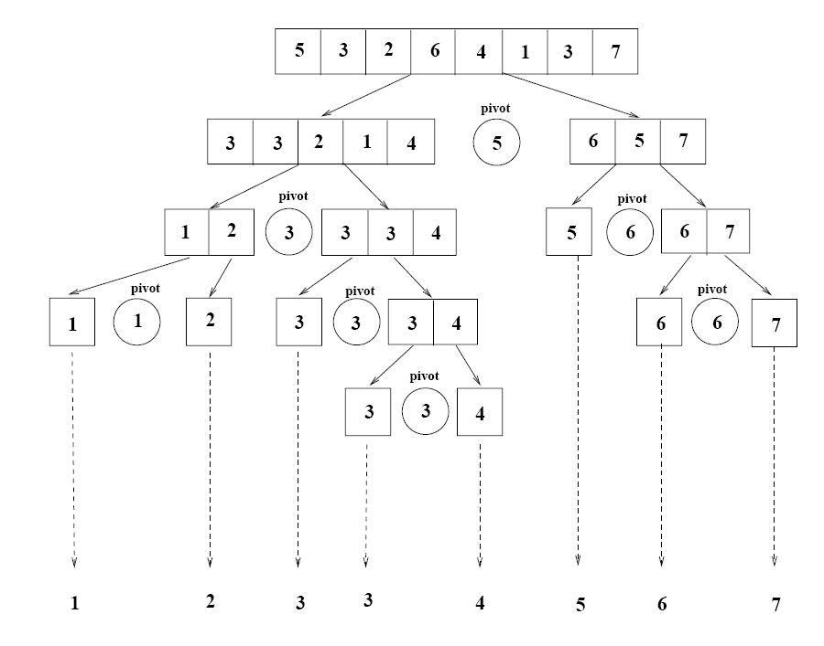
Example

Slide 59
Partitioning the Array
p
r
Alg. PARTITION (A, p, r)
x ← A[p]
i ← p – 1
j ← r + 1
while TRUE
do repeat j ← j – 1
until A[j] ≤ x
do repeat i ← i + 1
until A[i] ≥ x
if i < j
then exchange A[i] ↔ A[j]
else return j
A:
5
3
2
6
4
1
3
7
i
j
A[p…q]
≤
A[q+1…r]
A:
a_{p}
a_{r}
j=q
i
Each element is visited once!
Running time: Θ(n)
n = r – p + 1

Slide 60
Recurrence
Alg.: QUICKSORT(A, p, r)
if p < r
then q ← PARTITION(A, p, r)
QUICKSORT (A, p, q)
QUICKSORT (A, q+1, r)
Initially: p = 1, r = n
Recurrence:
T(n) = T(q) + T(n – q) + n

Slide 61
Worst Case Partitioning
Worst-case partitioning
One region has one element and the other has n – 1 elements
Maximally unbalanced
Recurrence: q=1
T(n) = T(1) + T(n – 1) + n,
T(1) = Θ(1)
T(n) = T(n – 1) + n
=
n
n
1
n - 1
n
1
n - 2
n - 1
n
1
n - 3
n - 2
1
2
3
1
1
2
Θ(n²)
When does the worst case happen?

Slide 62
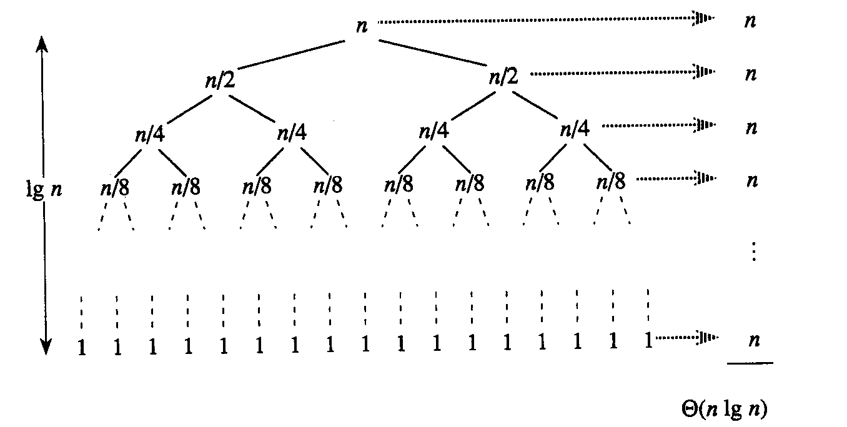
Best Case Partitioning
Best-case partitioning
Partitioning produces two regions of size n/2
Recurrence: q=n/2
T(n) = 2T(n/2) + Θ(n)
T(n) = Θ(nlgn) (Master theorem)

Slide 63
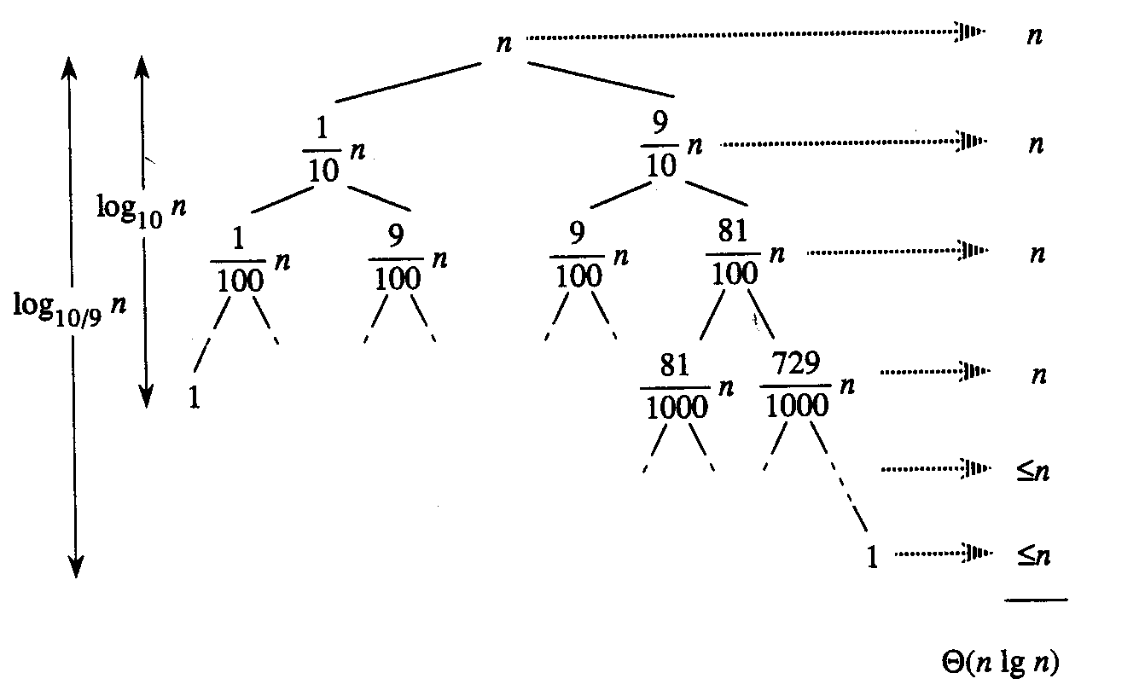
Case Between Worst and Best
9-to-1 proportional split
Q(n) = Q(9n/10) + Q(n/10) + n

Slide 64
How does partition affect performance?

Slide 65
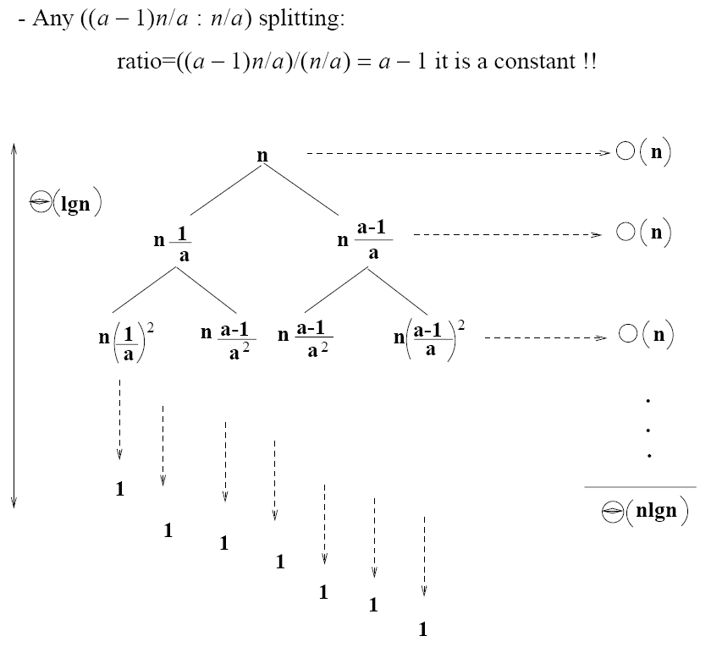
How does partition affect performance?

Slide 66
Performance of Quicksort
Average case
All permutations of the input numbers are equally likely
On a random input array, we will have a mix of well balanced and unbalanced splits
Good and bad splits are randomly distributed across throughout the tree
partitioning cost:
n = Θ(n)
n
combined partitioning cost:
2n-1 = Θ(n)
n
1
n - 1
(n – 1)/2 + 1
(n – 1)/2
(n – 1)/2
(n – 1)/2
Alternate of a good
and a bad split
Nearly well
balanced split
Running time of Quicksort when levels alternate between good and bad splits is O(nlgn)

